Slide 1
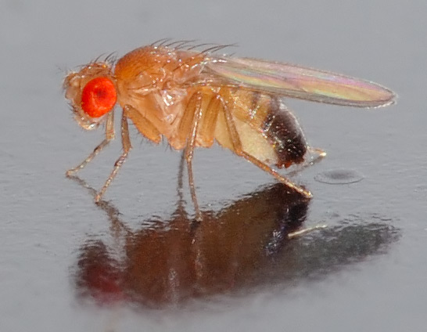
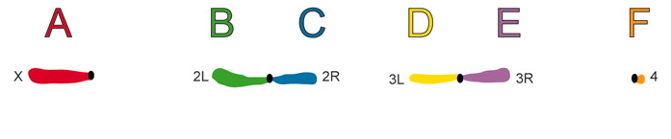
Fly T2T
Genome of Drosophila melanogaster
~175-180 Mbp
(excluding Y)
Notes:
134 Mbp that are correctly ordered and oriented
> 140 Mbp when you count the Y and unplaced or unknown scaffolds
> 160 Mbp when you consider everything we might ever discover

Slide 2

Access this talk and a poster from spring:
bit.ly/fly-t2t-f2f

Slide 3
Why Drosophila?
Small genome (~175-180 Mb)
Inexpensive to sequence (because of small genome)
Compact genes (euchromatic introns are small compared to humans)
Genetic model (first genetic maps¹, first x-ray mutagenesis², first CNV phenotype³, concept of synteny and birth of comparative genomics⁴, population genetics pioneer⁵⁻⁷, first wgs assembly⁸)
Little repetitive DNA content
Little repetitive DNA content
Notes:
Sturtevant, A. H. The linear arrangement of six sex-linked factors in Drosophila, as shown by their mode of association. Journal of Experimental Zoology 14, 43–59 (1913).
Muller, Hermann J. "Artificial Transmutation of the Gene." Science 66 (1927): 84–7.
Wolfner, M. F., & Miller, D. E. (2016). Alfred Sturtevant Walks into a Bar: Gene Dosage, Gene Position, and Unequal Crossing Over in Drosophila. Genetics, 204(3), 833–835.
Schaeffer S. W. (2018). Muller "Elements" in Drosophila: How the Search for the Genetic Basis for Speciation Led to the Birth of Comparative Genomics. Genetics, 210(1), 3–13.
Hubby, J. L., & Lewontin, R. C. (1966). A molecular approach to the study of genic heterozygosity in natural populations. I. The number of alleles at different loci in Drosophila pseudoobscura. Genetics, 54(2), 577–594.
Lewontin, R. C., & Hubby, J. L. (1966). A molecular approach to the study of genic heterozygosity in natural populations. II. Amount of variation and degree of heterozygosity in natural populations of Drosophila pseudoobscura. Genetics, 54(2), 595–609.
Kreitman M. (1983). Nucleotide polymorphism at the alcohol dehydrogenase locus of Drosophila melanogaster. Nature, 304(5925), 412–417.
Adams, M. D., et al. (2000). The genome sequence of Drosophila melanogaster. Science (New York, N.Y.), 287(5461), 2185–2195.

Slide 4
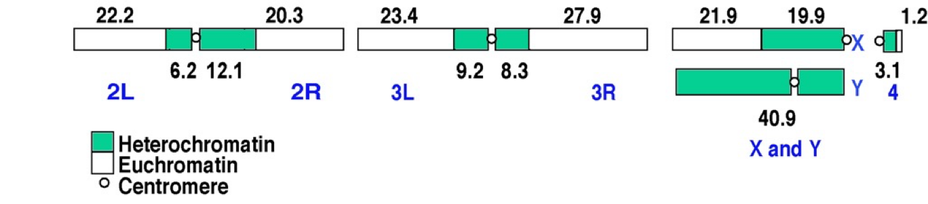
State of the Drosophila genome in 2000
 | Chr X | Chr 2 | Chr 3 | Chr 4 | Chr Y
Expected | ~40 Mb | ~60 Mb | ~70 Mb | ~4.3 Mb | ~40 Mb
Sequenced | 21.9 Mb | 42.5 Mb | 51.3 Mb | 1.2 Mb | 0
Deficit | 18.1 Mb | 17.5Mb | 18.7 Mb | 3.1 Mb | ~40 Mb
Adams et al. 2000
Notes:
Seas of satellites (100s or 1,000s of KB)
islands of scrambled TEs (10s or 100s of KB)

Slide 5
State of the Drosophila genome in 2022
Expected
~40 Mb
~60 Mb
~70 Mb
~5 Mb
~40 Mb
Rel 6 + C&L*
23.5 Mb
48.8 Mb
60.2 Mb
1.3 Mb
14.5 Mb*
HiFi + C&L*
27.4 Mb
50.5 Mb
63.0 Mb
1.3 Mb
Deficit
13-17 Mb
10-11 Mb
7-10 Mb
3.7 Mb
25 Mb
142 Mbp of 175Mb: ~20% is missing (excluding Y)
Rel 6: Hoskins et al. 2015
C&L: Chang and Larracuente 2019
HiFi: Shukla & Emerson, unpublished
Notes:
Release 6 from 2015 represents the limits of what is practically achievable with established clone-based methods for mapping, sequencing, and assembling
Image from: Hales, K. G., Korey, C. A., Larracuente, A. M., & Roberts, D. M. (2015). Genetics on the Fly: A Primer on the Drosophila Model System. Genetics, 201(3), 815–842.
Hoskins, R. A., et al. E. (2015). The Release 6 reference sequence of the Drosophila melanogaster genome. Genome research, 25(3), 445–458.
Chang, C. H., & Larracuente, A. M. (2019). Heterochromatin-Enriched Assemblies Reveal the Sequence and Organization of the Drosophila melanogaster Y Chromosome. Genetics, 211(1), 333–348.

Slide 6
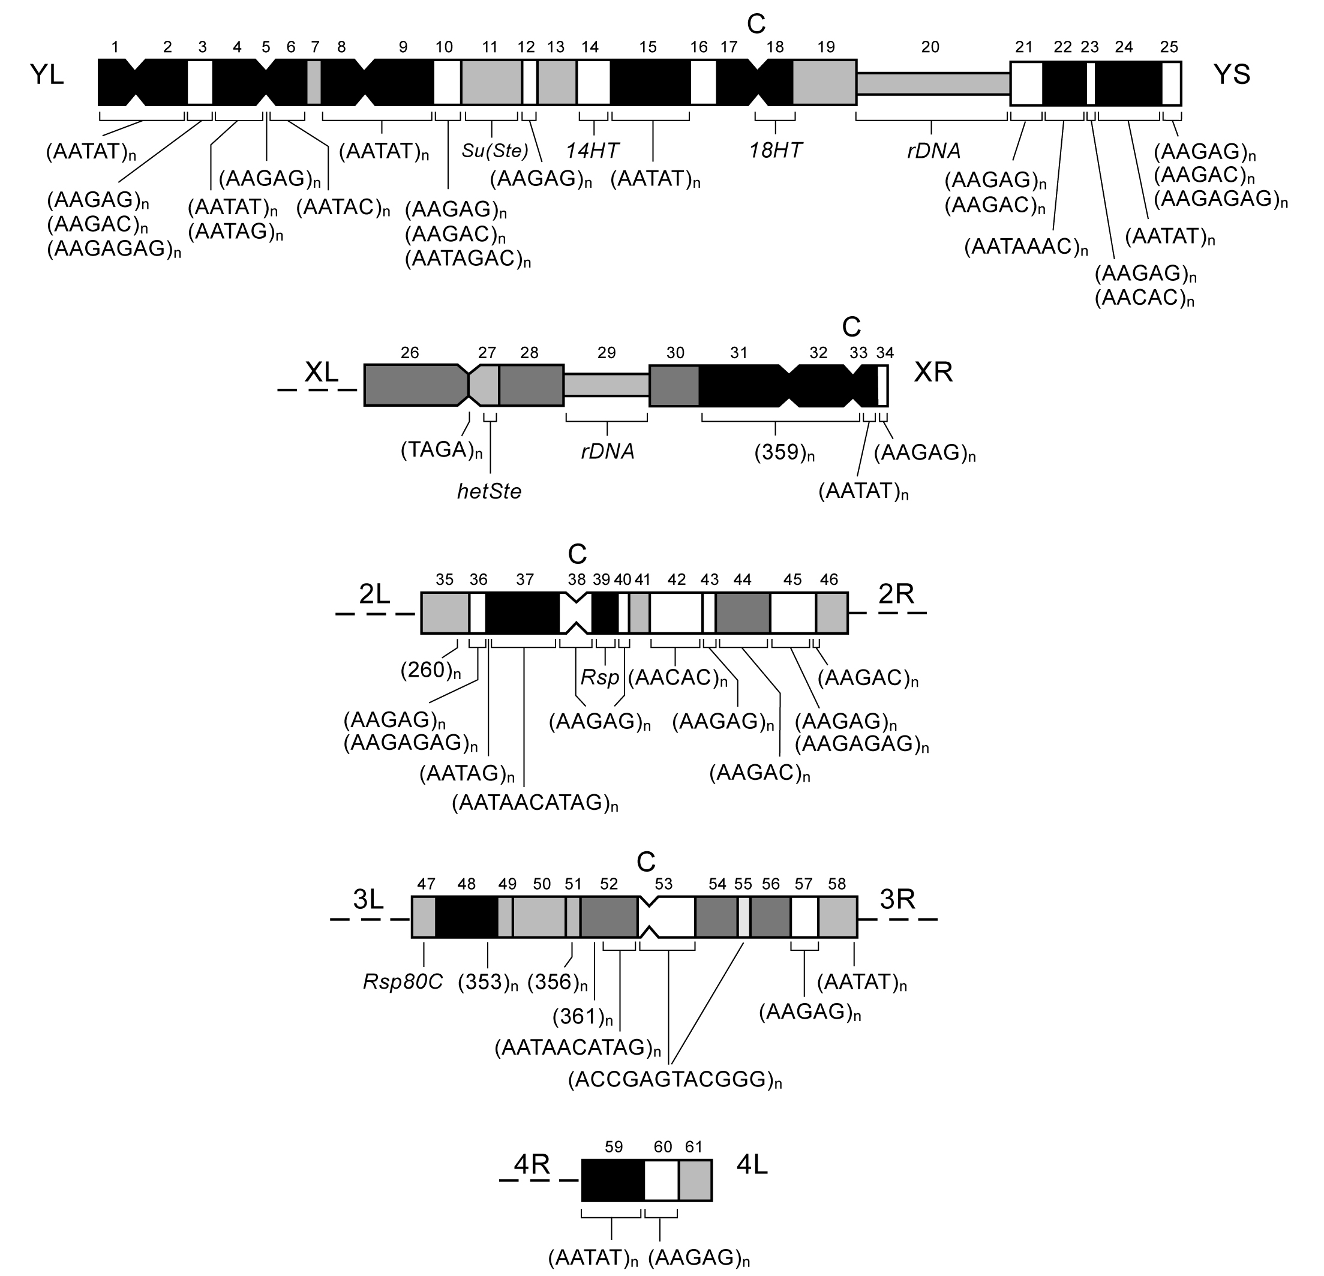
Where are the problems?
NOT most of the euchromatin
Histone cluster
rDNA cluster
Centric heterochromatin
Y-chromosome
Notes:
We’ve already got a pretty good handle on the Histone Cluster with HiFi
rDNA is highly likely to be assembled, unlike human, due to promoter variation plus 28S TE insertions in ~1/3 (plus they are shorter than human, ~17kb each, not 45kb)
(AAGAG)n: ~8Mb on X-3; another 7.4Mb on Y and 4
359 of 1.688: 10-11Mb on the X
Problems affect regions that participate in cellular processes like DNA packaging, protein translation, chromosome segregation, genome integrity, male differentiation
You know, the unimportant things

Slide 7
Why so much trouble?
Large repeat arrays, particularly satellites, that span hundreds of kilobases or even megabases
Many of these are underrepresented in PacBio datasets (e.g. Khost and Larracuente 2017)
Perhaps DNA isolation biases, like salivary gland underreplication (e.g. thorax tissue in Hjelmen et al. 2020)?
Yet, one can still estimate genome size from flow cytometry (brain tissue, typically) and it’s about 175 Mb
Notes:
Replication of heterochromatin is limited or absent in some cells (underreplication), perhaps contributing to incomplete assemblies based on DNA isolated from adults
From 32-47Mb of the genome is underreplicated in thoracic tissue, e.g. (10.1111/evo.14022)
Khost, D. E., Eickbush, D. G., & Larracuente, A. M. (2017). Single-molecule sequencing resolves the detailed structure of complex satellite DNA loci in Drosophila melanogaster. Genome research, 27(5), 709–721.
Hjelmen, C. E. et al. (2020). Thoracic underreplication in Drosophila species estimates a minimum genome size and the dynamics of added DNA. Evolution; international journal of organic evolution, 74(7), 1423–1436.

Slide 8
Approach
Isogenic diploid samples (ie, haploid data from the perspective of assembly)
Males to recover the Y
Classic reference strain (dubbed “iso-1”, which was genetically isogenized in the late 80s/early 90s)
“Interesting” divergent strain (ie centromeres aren’t closely related)
2.5 hr embryo samples (HiFi collection complete; ONT UL collection ending this week)
20kb HiFi (in progress)
ONT Ultralong libraries (planned)
Verkko

Slide 9
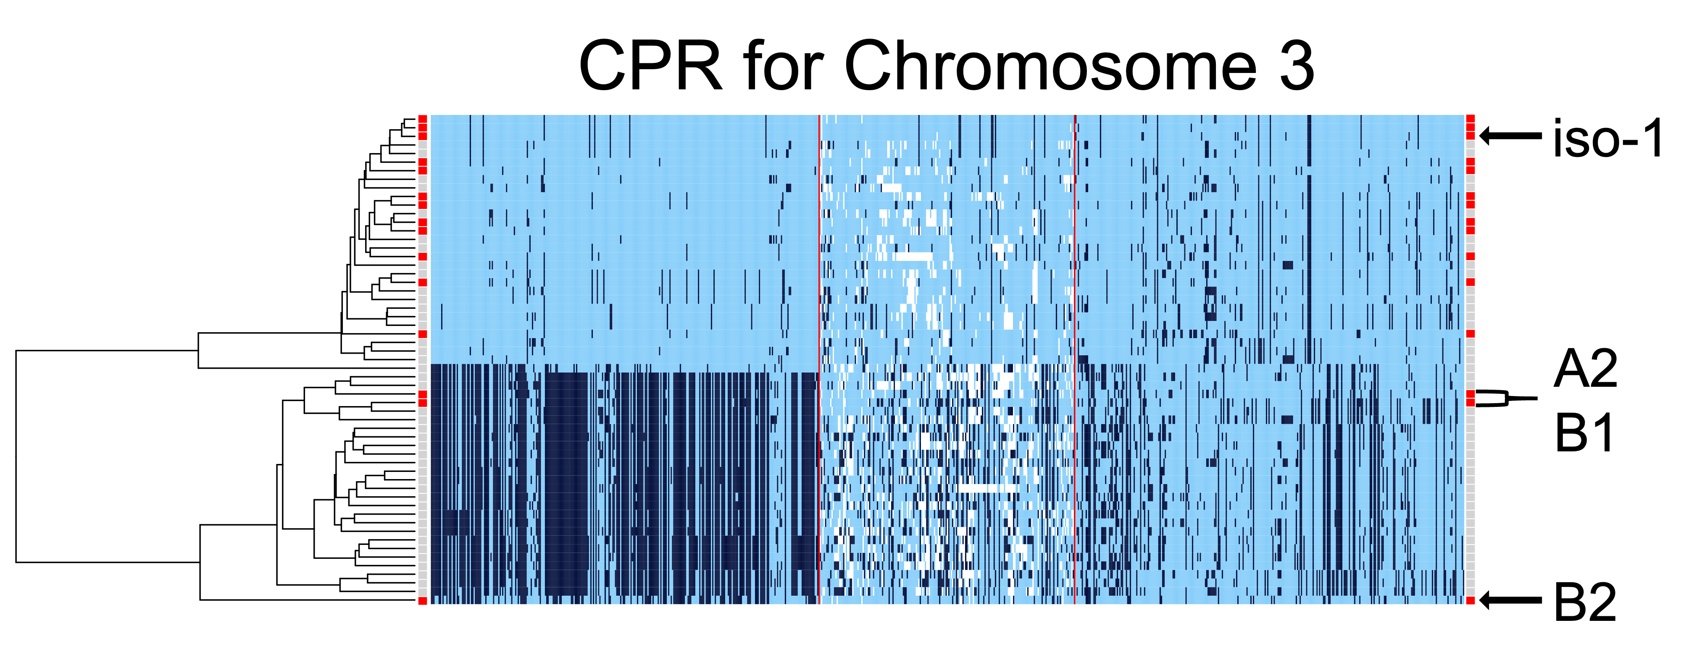

Interesting centromeres
Langley & Langley

Slide 10
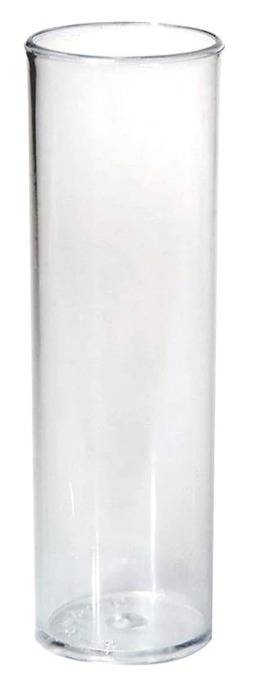
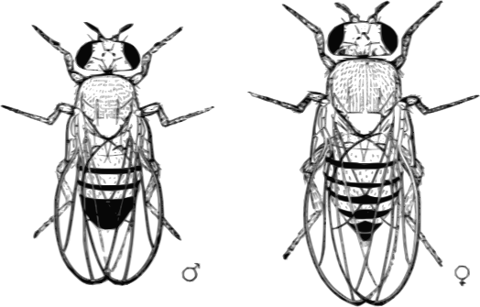

Inbreeding scheme
Parental stock
G₀ stock
G_{N} stock
N times
Chakraborty & Shukla
Notes:
Parental stock has low diversity
Concern about segregating variants
First cross reduces maximum diversity to 4 haplotypes
Each inbreeding reduces diversity

Slide 11
Satellite kmer diversity
Courret & Larracuente

Slide 12
Satellite kmer diversity
Expectation with variation
Observation
Inbreeding Generation
Inbreeding Generation
Courret & Larracuente

Slide 13
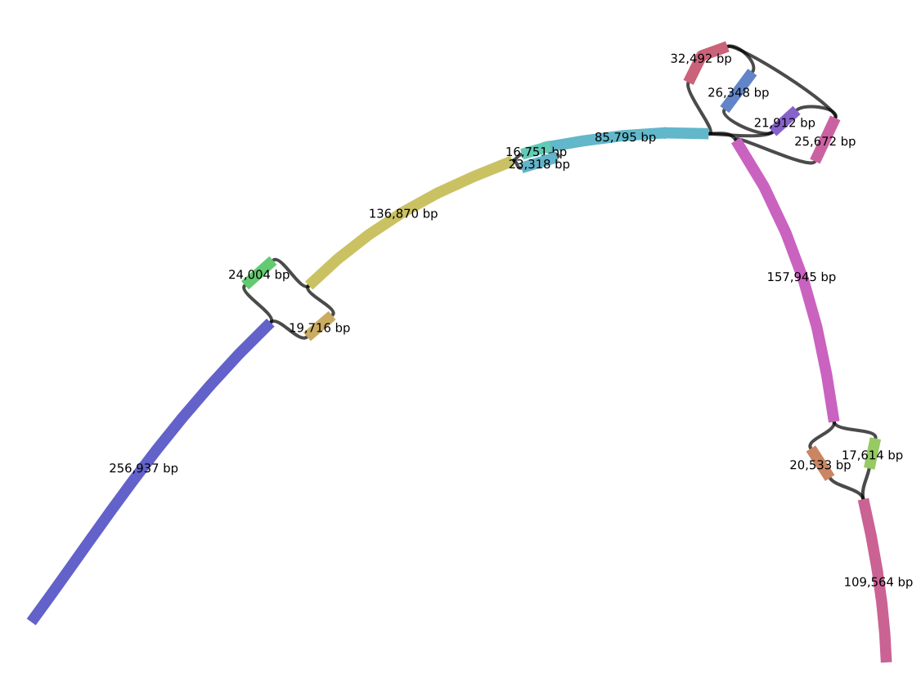
HiFi alone is already assisting with some tough regions
Pickett & Phillippy
Shukla & Emerson
Notes:
An alternative assembly of HiFi data in Drosophila melanogaster. More repetitive regions were recovered with HiFi data than in previous assemblies, including the histone cluster and part of the rDNA (Poster 298C). A: A Bandage⁷ plot showing a much simpler graph structure in the histone cluster region. B: Comparison between iso-1 and DSPR’s A4 in the histone cluster indicating both differences in the configuration and content of the array.

Slide 14
The future
What’s left for T2T?
Beyond T2T
Sequence and assemble iso-1 (in progress)
Collect A2 embryos (struggles with sluggish strain!)
Sequence and assemble A2 (soon)
Polymorphism samples (pangenomes)
Testing platform with ground truth: iso-1 x A2 F1 hybrids for phased assembly
T2T parental haplotypes for diploid F1 will be available
SV analysis
Heterochromatin characterization
rDNA
Ideas?

Slide 15

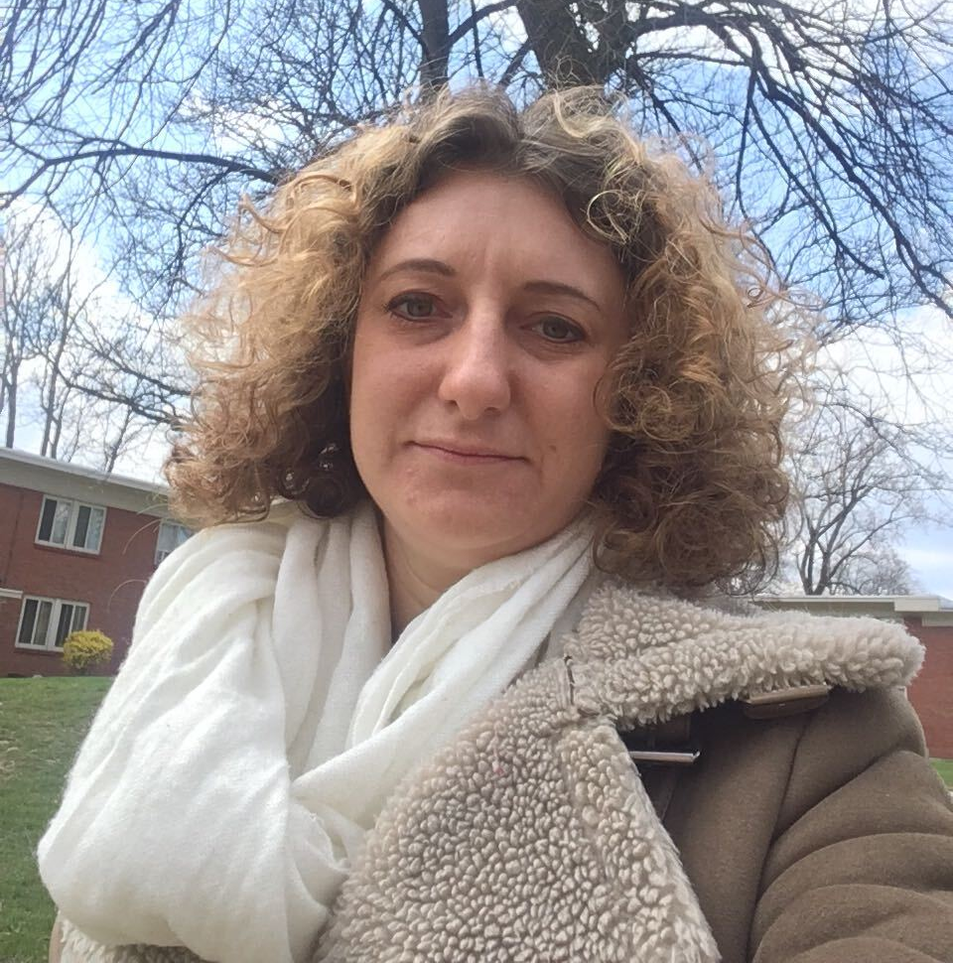
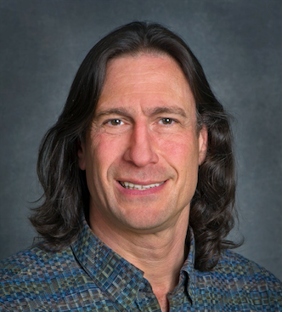
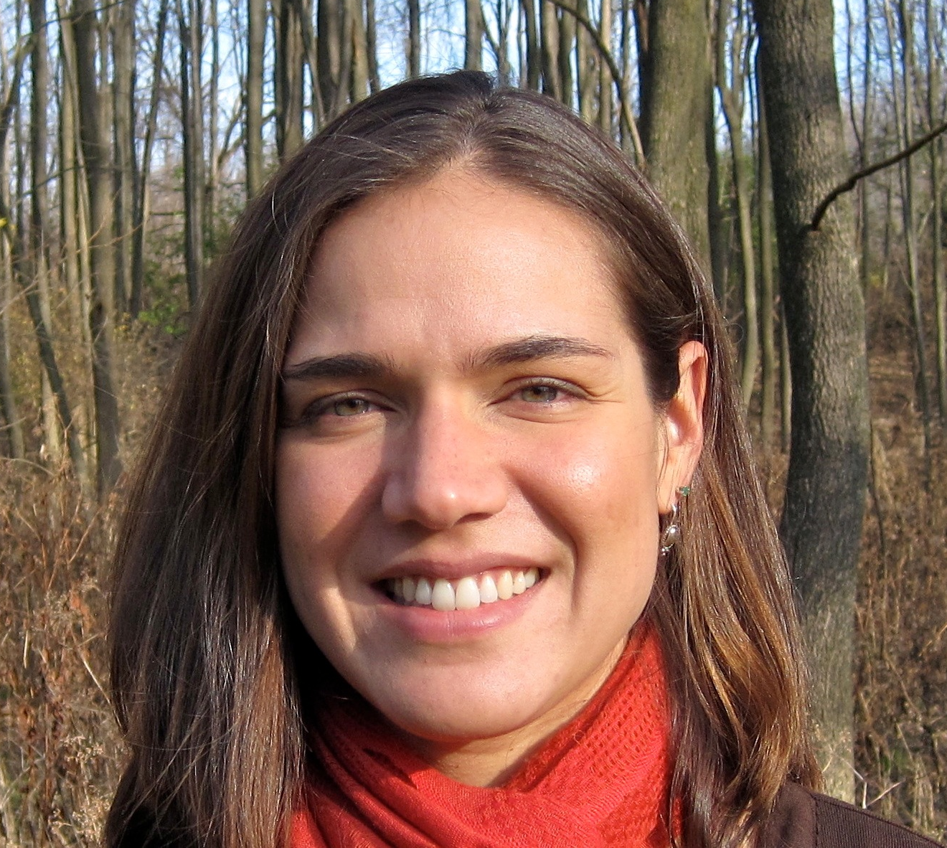

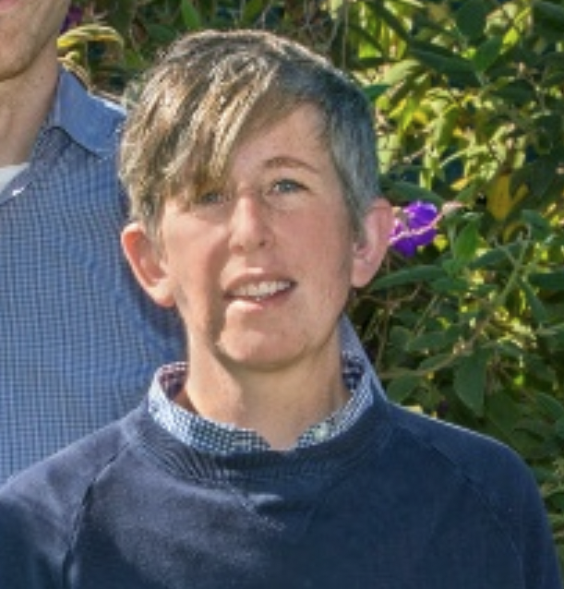
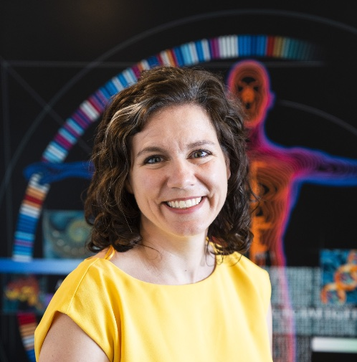
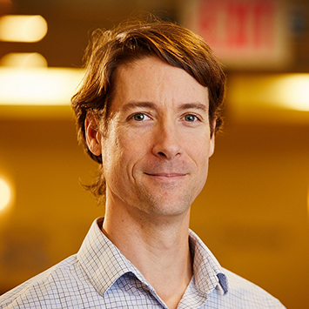
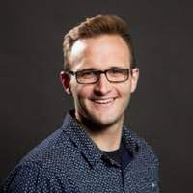
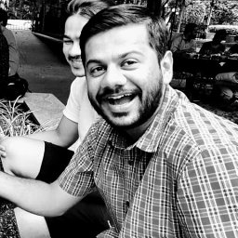
Chakraborty
Courret
Karpen
Larracuente
Langley
Langley
Miga
Phillippy
Pickett
Shukla

Slide 16
Acknowledgments
Nicolas Altemose¹ Susan E. Celniker² Mahul Chakraborty³ Cécile Courret⁴ Gary H. Karpen^{1, 2} Bernard Y. Kim⁵ Charles H. Langley⁶ Sasha Langley¹ Amanda M. Larracuente⁴ Barbara G. Mellone⁷ Karen H. Miga⁸ Danny E. Miller^{9,10} Rachel J. O’Neill⁷ Adam M. Phillippy¹¹ Brandon D. Pickett¹¹ Harsh G. Shukla³
1. University of California, Berkeley, Berkeley, CA 2. Lawrence Berkeley National Lab, Berkeley, CA 3. University of California, Irvine, Irvine, CA 4. University of Rochester, Rochester, NY 5. Stanford University, Stanford, CA 6. University of California, Davis, Davis, CA 7. University of Connecticut, Storrs, CT 8. University of California, Santa Cruz, CA 9. University of Washington, Seattle, WA 10. Seattle Children's Hospital, Seattle, WA 11. National Human Genome Research Institute, NIH, Bethesda, MD

